Slide 1
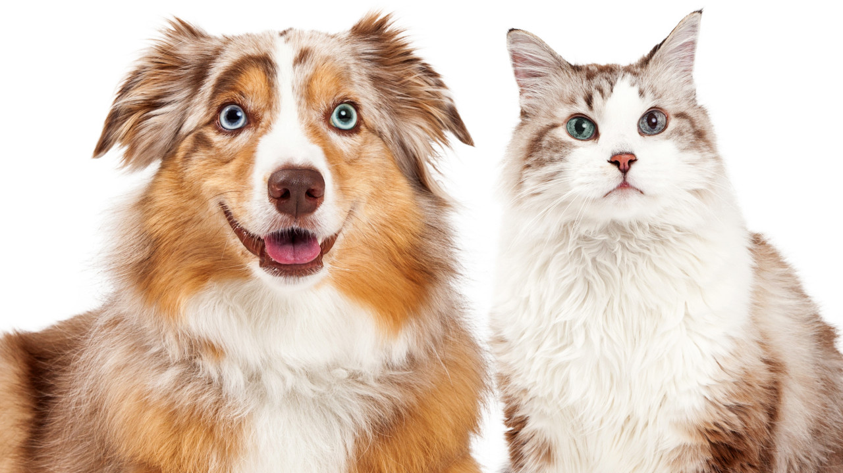
Image Classification - Cats, Dogs and Butterflies
Amanda Tavares
Arina Sanches
Lirielly Nascimento

Slide 2
Outline
Experiments
Dataset Analysis
Data Augmentation
VGG-16 Architecture
EficientNet B7 Architecture
Available pre-trained weights models in Keras
Execution Results
Reinforcement Learning
RL - Execution Results
Bibliography

Slide 3
Experiments
VGG1
VGG2
VGG3
Dropout
Data Augmentation
Transfer Learning
VGG16
EfficientNetB7
Steps followed
2 classes: dogs and cats
2 classes with data augmentation: dogs and cats
3 classes: dogs, cats and butterfly

Slide 4
Dataset analysis

Slide 5

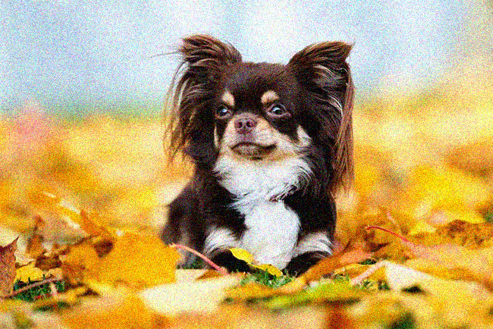

Data Augmentation
original image
gaussian white noise
blocking mask
+ 1000 for cats + 1000 for dogs
+ 2000 for cats + 2000 for dogs

Slide 6
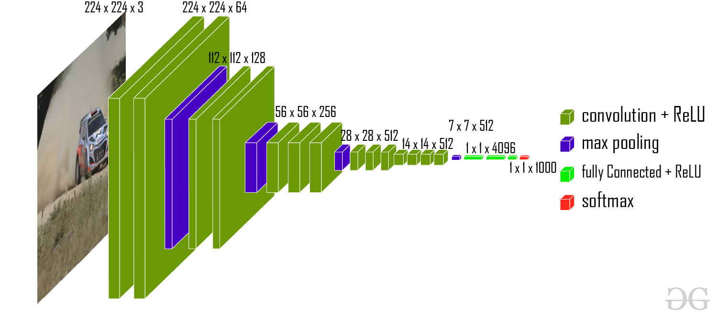
VGG-16* Architecture
*depth: 16 weighted layers

Slide 7
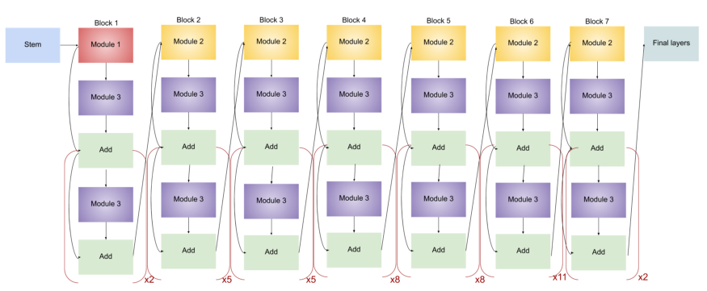
EfficientNet B7* Architecture
*depth: 438 weighted layers

Slide 8
Available pre-trained weights models in Keras

Slide 9
Execution Results

Slide 10
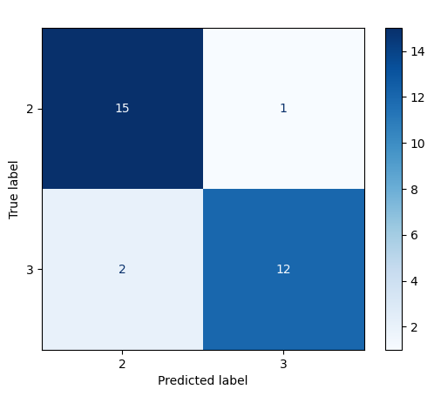
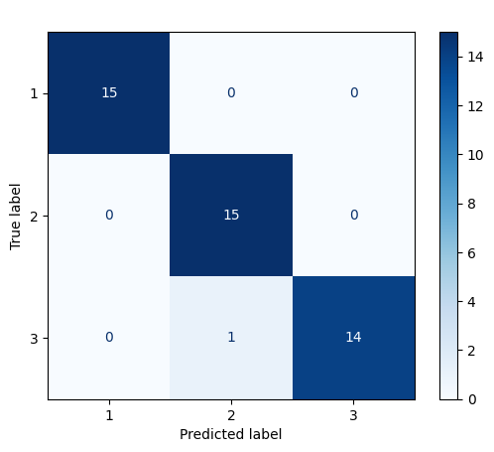
Another way of training using tabular data
Features created:
size of nose;
shape of ears;
hair;
wings;
animal size;
antenna.
Dataset observations:
50 observations for each class (cat, dog and butterfly).
Butterfly
Cats
Cats
Dogs
Dogs
Cats
Dogs
Butterfly
Cats
Dogs

Slide 11
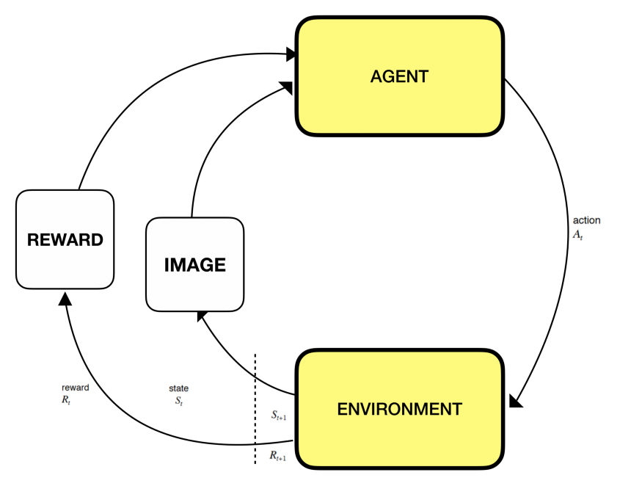
Reinforcement Learning
1 - State: The state s in the environment is the training sample, which would be the image sample in our case.
2- Action: The action a of the agent is the label of the training sample. As we have a binary problem, where the agent is only able to choose from the set of actions A = {0,1}, 0 is the cat class and 1 is the dog class.
3- Reward: The reward r is the feedback that the environment gives back to the agent for it to measure its success in classifying the state s correctly.

Slide 12
Reinforcement Learning
4- Discount factor: The factor 𝛾 ∈ [0,1], it weighs in the importance of future rewards. Since we are working on image classification, then consecutive samples are not correlated, and each image needs to be classified correctly. Therefore, a low value for 𝛾 would be a better choice.
5- Exploration rate: The rate ε ∈ [0,1], when it is set to 1, this means that the actions taken are purely based on exploration, on the other hand, if the value is 0 the actions taken are an exploitation of the agent’s knowledge.
6- Episode: The episode e ends when all the training samples in the training set have been passed for the agent to classify.

Slide 13
RL - Execution Results

Slide 14
Bibliography
How to Classify Photos of Dogs and Cats
Keras Applications
Complete Architectural Details of all EfficientNet Models
VGG-16 | MODELO CNN
Using deep q-learning in the classification of an imbalanced dataset

